Slide 1
Quality Alloys
Data Pirates Team 11

Slide 2

Outline of Quality Alloys
Small B2B Company
Expertise in the industry
Maintains competitive advantage
Uses traditional methods of marketing
Has clear future goals/expansion
Notes:
KC
Good afternoon everyone, we are data pirates team 11. Today we are going to talk about Quality Alloys and their marketing strategy. Quality Alloy is a small B2B company whose target market are other small companies who do not need to purchase alloys in bulk amount. They are experts in the industry who also provide consulting services to their clients, and maintain competitive advantage by having a good reputation within the field. In the case, they explain that they had only used traditional methods of marketing to expand their business. In 2008, Quality Alloys decided to create a website to establish their global presence. Furthermore, they have clear goals for future expansion.

Slide 3
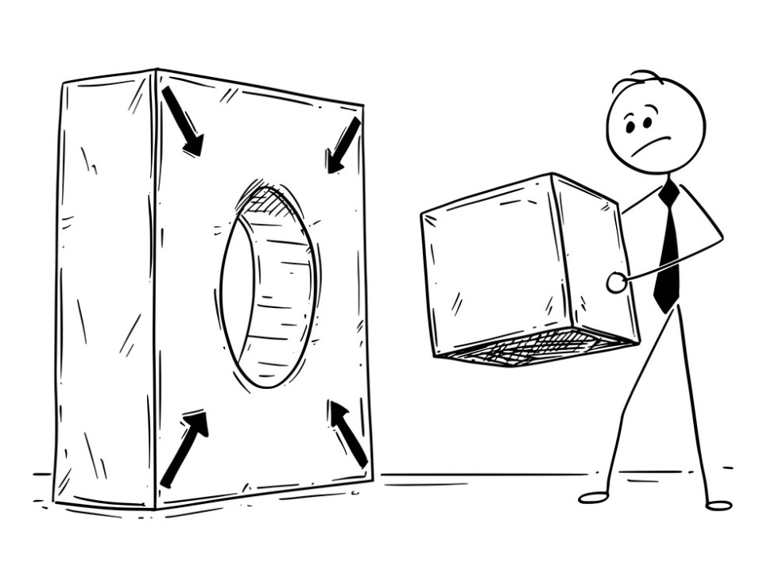
Problem
Unable to make sense of their data
Do not have validation for their actions
Underdeveloped website
Outdated marketing strategy
Limited budget
Notes:
KC
A few problems that arise in Quality Alloys is that they have problems making sense of the data they collect. Therefore it is hard to validate their actions and decisions with solid evidence, such as the promotional program that will be discussed later. Quality Alloys has an underdeveloped website where clients have to submit a request to the company via web-form in order for them to get in contact, which is extremely inefficient. Their traditional marketing strategy is becoming more and more outdated, and since they are a small company, there is a limited budget on what they can spend on.

Slide 4


Website
B2B website, with sales team follow up
Only requests were allowed (no automation)
Unable to order products/samples online
Transparency of company information
Brand building/awareness
Notes:
The QA website is a B2B website. The main goal of the website was to increase sales, make product and contact information available and adding legitimacy to the brand. The website was not designed to allow users to enter orders over the web. However, in addition to providing descriptions of the products and services offered by QA, the website does allow potential customers to submit request for quotations; that is, a request to be contacted. These requests are given to inside sales staff for follow up. As is the case for other business-to-business (B2B) providers, there’s no direct way to connect a visit with a sale as there is no “shopping cart” on the website.

Slide 5

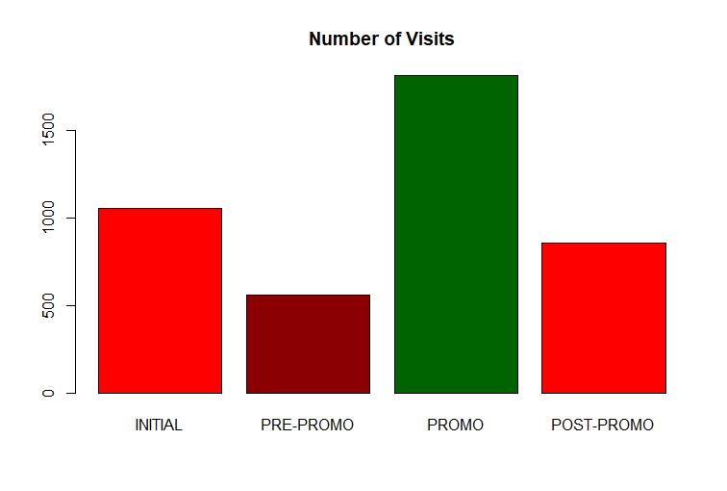


Talking About The Promotion
S. America
Visits: 22,616
Kindly look at the Promotion’s in Graph
Visits: 17,681
Visits: 38,754
Notes:
Sarthak

Slide 6
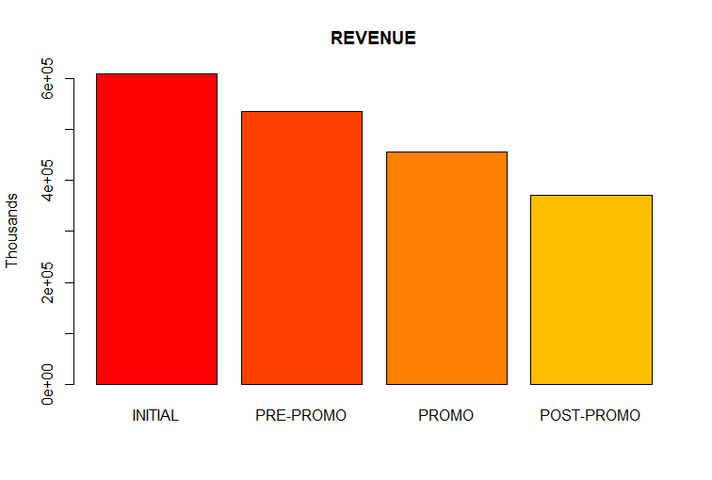
Models- Promotions vs. Revenue
Decrease in Revenue
No Direct Impact
Notes:
Sarthak

Slide 7
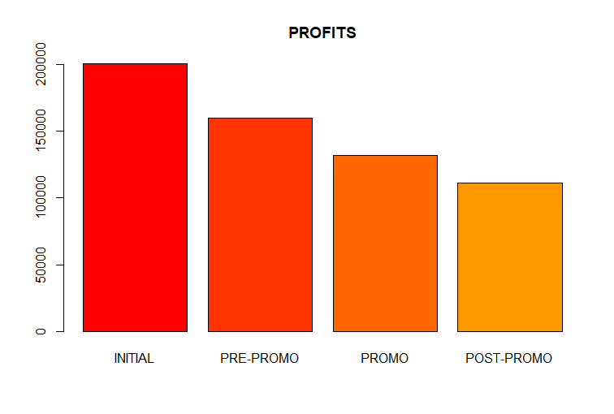
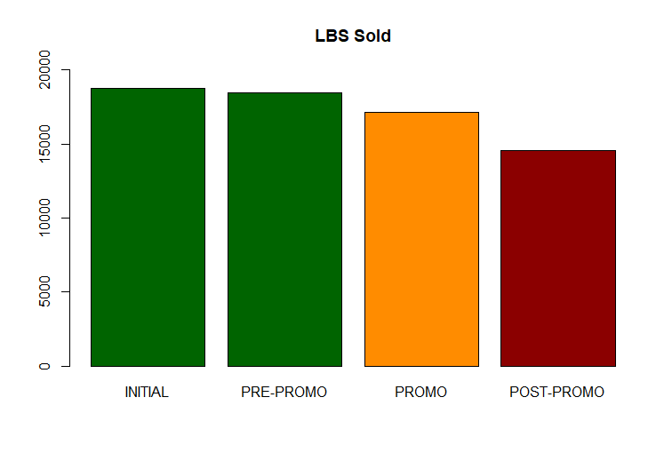
Promotions vs. Profits & Lbs Sold
1.5%
7.2%
20.1%
14.8%
17.5%
15.8%
Lbs sold did not decrease, nonetheless the profits went down drastically.
Reason: Expenditure on Promotion
Notes:
Sarthak
Because, the share of profit was spent on promotions

Slide 8
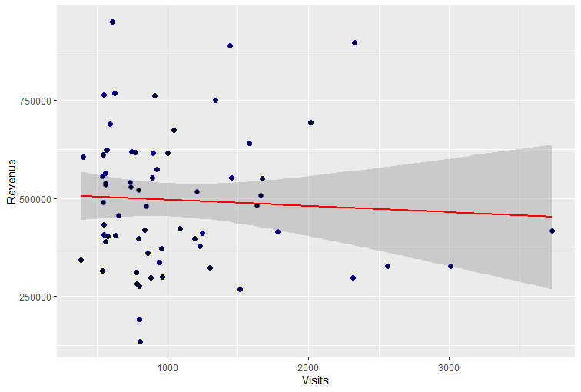
Website Visits vs. Actual Revenue
Decrease in revenue.
Users not interested in products, visit the website because of promotions.
Notes:
As Sarthak mentioned, the visits in promotional phase increased drastically, but as we can see from the graph the revenue has decreased. This can be caused by, the visitors who are not interested in the products are visiting the website because of the promotional advertisements all over the web.

Slide 9
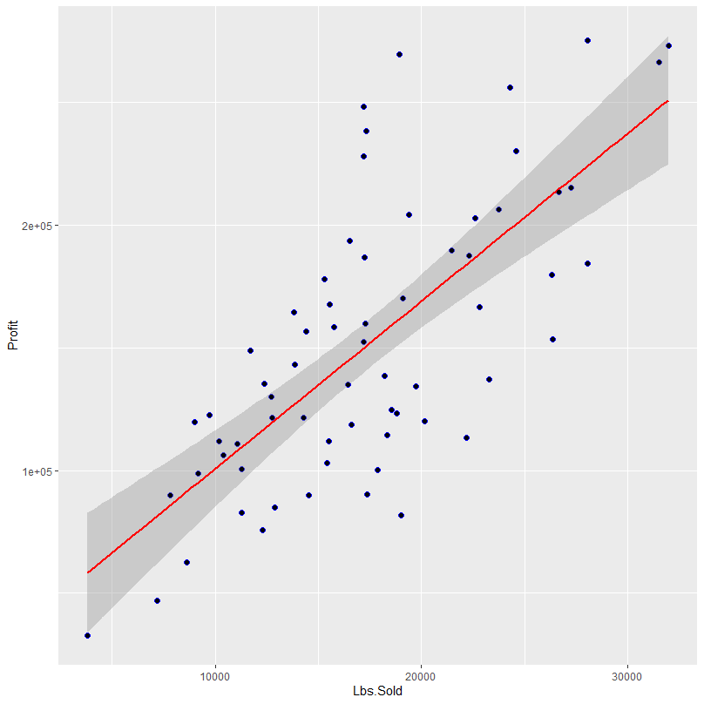
Describing a more accurate relationship (Pounds vs. Profit)
Visits vs. Revenue does not show a direct relationship.
B2B requires a more tangible offering.
Pounds sold is a more accurate variable to measure success.
Still not an efficient model to make predictions.
More variables are needed.
Notes:
Marco

Slide 10
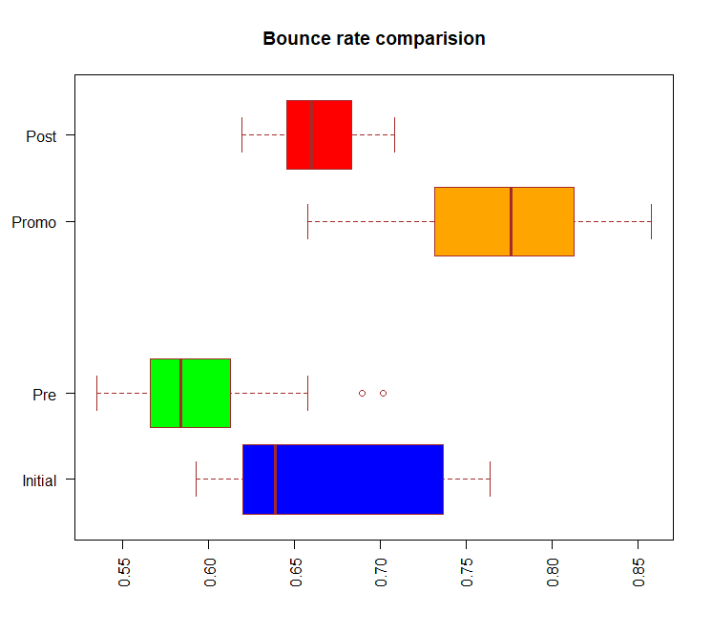
Final observation
The average bounce increased during promotion.
Nonetheless all point to the fact that this was random.
Notes:
JP
The average bounce rate mean shows that it has increased during the promotional period
Thus confirming that the bounce rate has dramatically increase during that period

Slide 11


Recommendation
Refocus their marketing campaign
Revisit the attractiveness of the website
Convert new customers for profit
Target right !
Notes:
Jp
To target the right group of customer
Convert new customer to profitable for the long run business
Since promotional period was very successful in grabbing attention of new customers, use it to their advantage. Even though they lost revenue and profit from the promotion, they had a massive increase of customer awareness of their product/brand. If they want to succeed, try to convert those new customers for a profitable long run business. As for advertising, try to discount less or give away free samples (instead, try to give your product more value than your competitors).

Slide 12
Thank You!
Team 11<- c( “JP”, “KC”, “Marco”, “Shree”, “Sarthak” )
San Francisco, 11/23/2019 | Hult

Slide 13
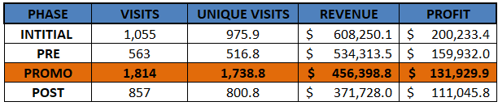
Appendix

Slide 14
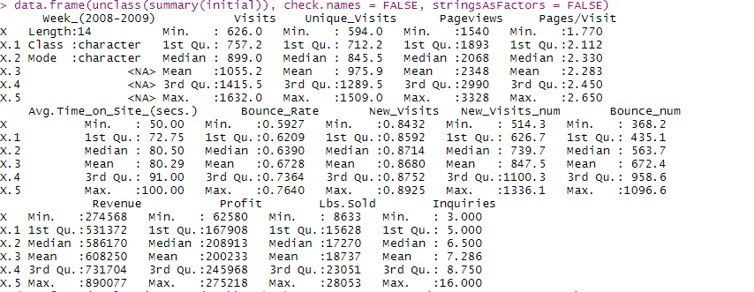
Appendix

Slide 15
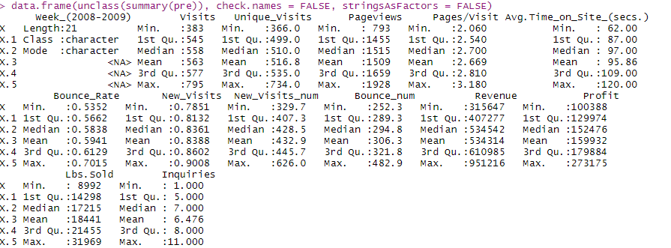
Appendix

Slide 16
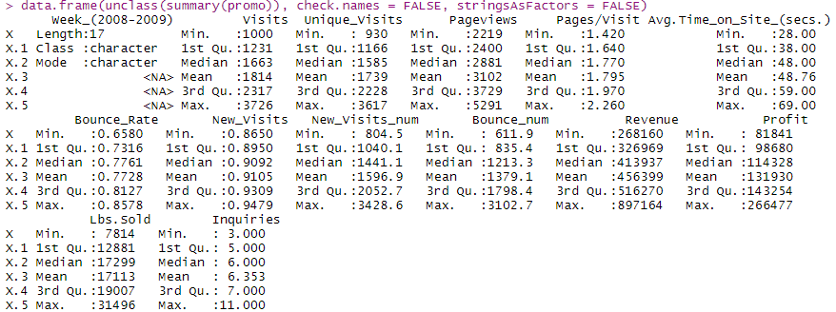
Appendix

Slide 17
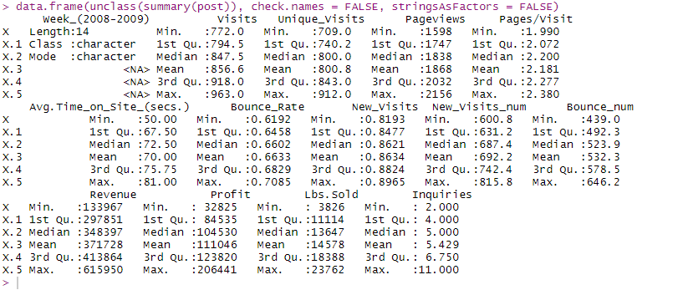
Appendix

